Slide 1
Pedestrian Wayfinding for People with Disabilities
Southwestern Pennsylvania Partnership for Aging 2017 Annual Conference
Presented by: NICK SINAGRA, SOFTWARE DEVELOPER, PATHVU

Slide 2
Agenda
Background
Current Guidelines
pathVu Mission
Problem
Data Collection Tools
Data Visualization
Data Analysis
Partners

Slide 3
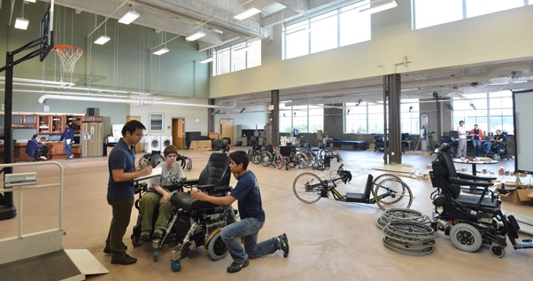
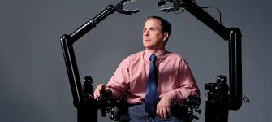
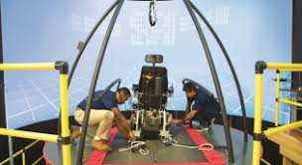
University of Pittsburgh and Human Engineering Research Laboratories

Slide 4
The Problem
1 in 3 older adults trip and fall each year
Wheelchair users
Falling out of the wheelchair is leading cause of injury
Say physical environment limits community participation
Poorly maintained sidewalks can cause dangerous vibrations
This limits
Safety
Trip and fall injuries
Dangerous vibrations
Obesity
Community participation
Transit ridership
!
Total cost of this issue is $34 Billion in direct medical bills annually in the U.S.
Notes:
What we’re looking for here: simple problem statement + clear indication of magnitude. Is this a problem worth investing in? Exact wording of magnitude statement will of course vary – it may be about money, lives, etc.

Slide 5
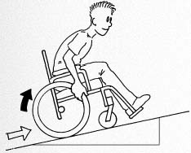
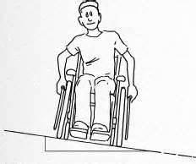
ADAAG and PROWAG
Americans with Disabilities Act (ADA) Accessibility Guidelines
Public Rights of Way Accessibility Guidelines (PROWAG)
Access Board governs PROWAG/ADAAG
PROWAG Guidelines
Curb Ramps
Access Aisles
Pedestrian Signals
Running Slope (5 deg or grade of road)
Cross Slope (2 deg)
Level Change (1/4” or 1/2”)
Width (4 feet)
Stable, Firm, and Slip Resistant
Roughness??

Slide 6
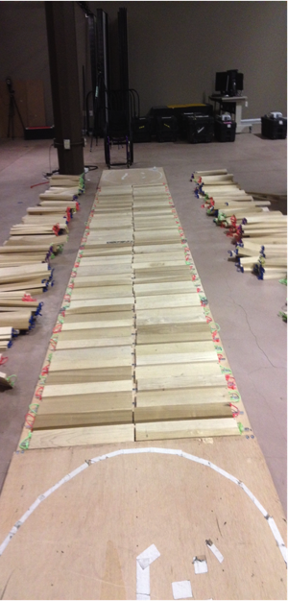
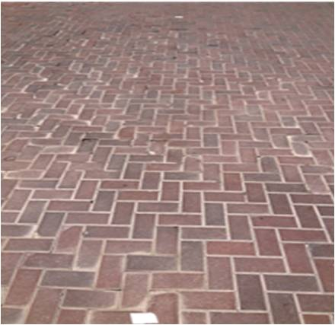
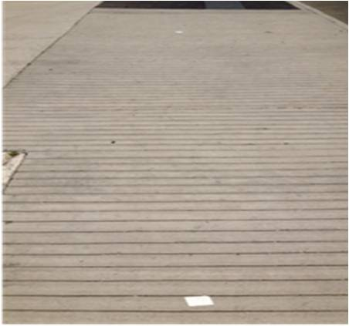
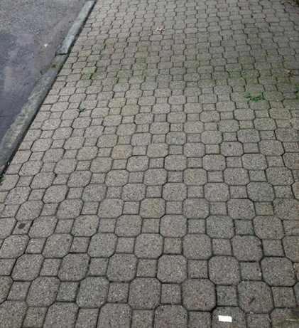
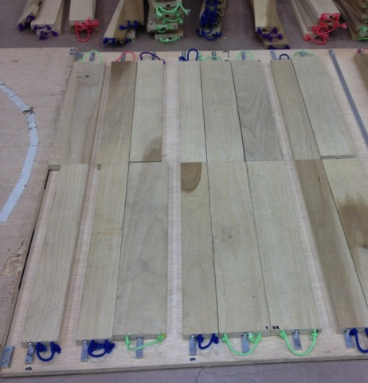
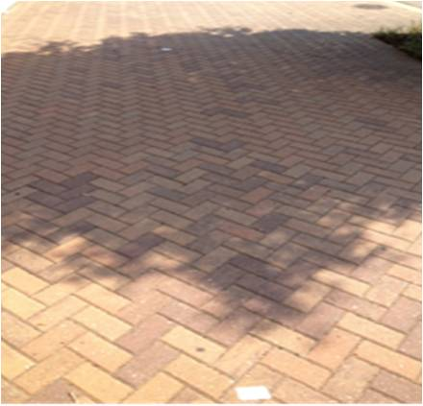
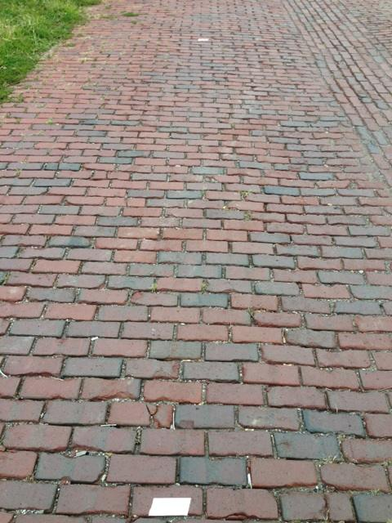
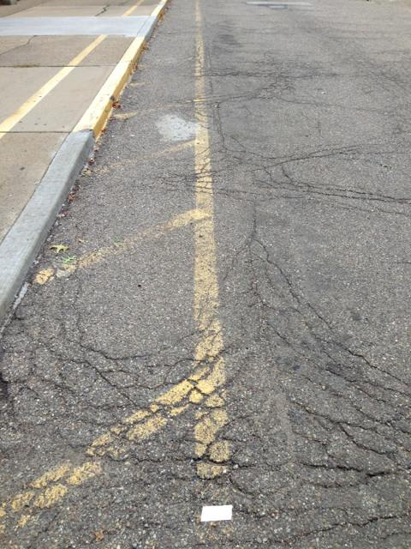
Roughness Standard
Standard Practice for Computing Wheelchair Pathway Roughness Index related to User comfort, acceptance and Whole body vibrations from longitudinal profile measurements
ASTM 3028-16

Slide 7
pathVu Mission
To build a global database of sidewalk and pedestrian pathway data to improve the accessibility, walkability, and safety of all pedestrians – of all abilities.

Slide 8
Current Sidewalk Data
Many cities do not have GIS maps of sidewalks/crosswalks
Lack of sidewalk data can make it difficult to prioritize improvements
Current pedestrian navigation methods utilize the road network instead of sidewalk maps

Slide 9
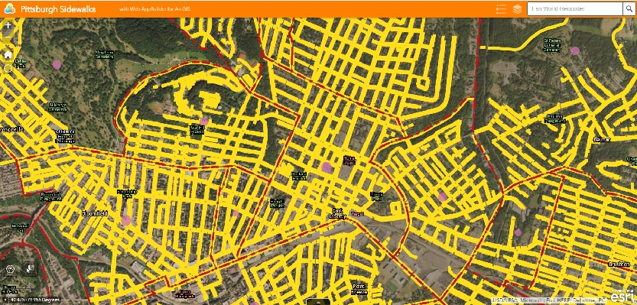
Sidewalk Map Creation
GIS Software
ArcGIS
Google Maps/Earth
OpenStreetMap

Slide 10
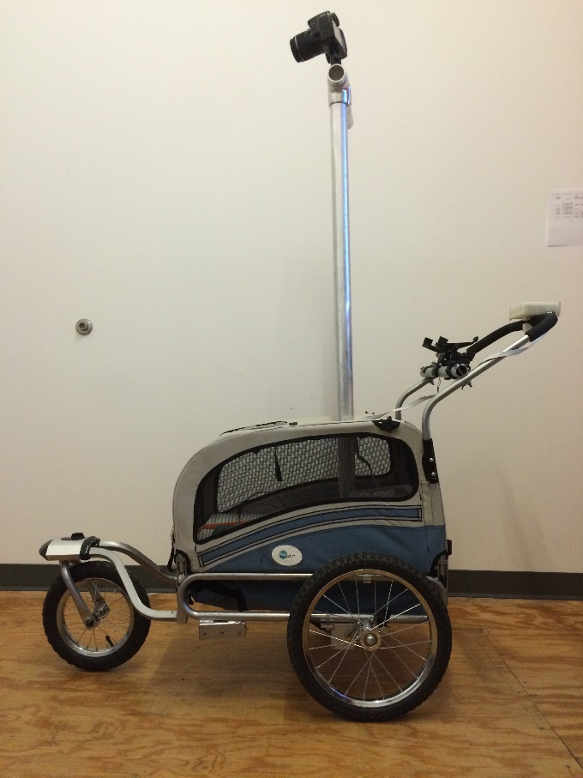
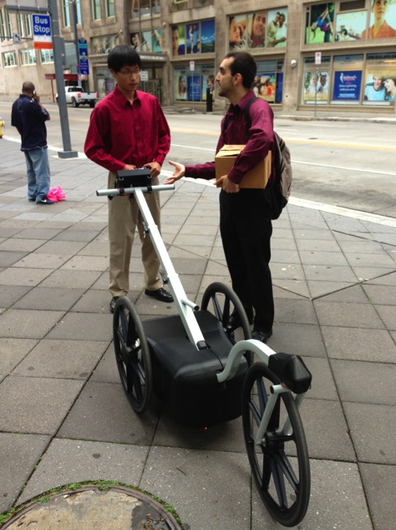
PathMeT
High resolution data
Output Measurements
Tripping hazards
Roughness
Depressions
Running slope
Cross slope
Images (Every 10 feet)
GPS location

Slide 11
PathMeT Data Visualization

Slide 13
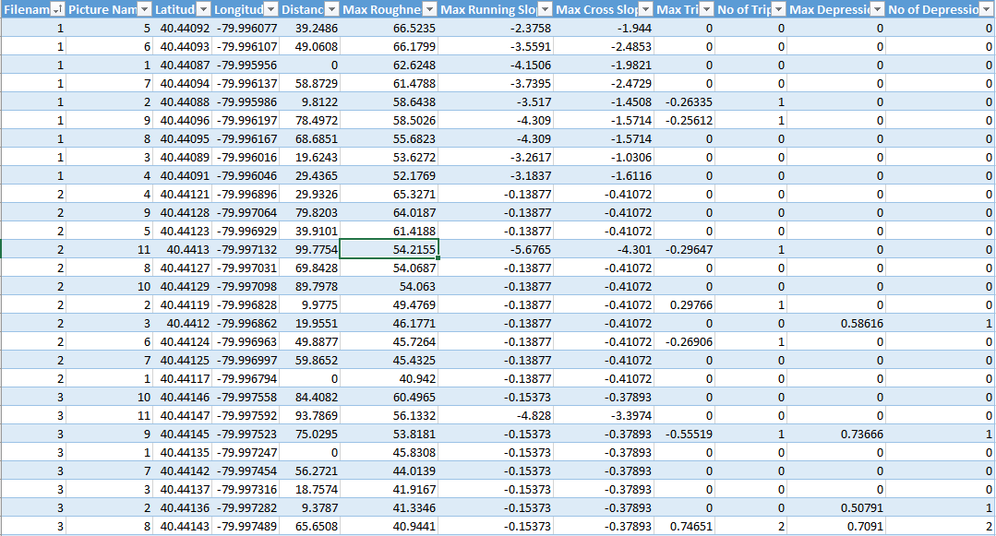
Excel Data

Slide 14
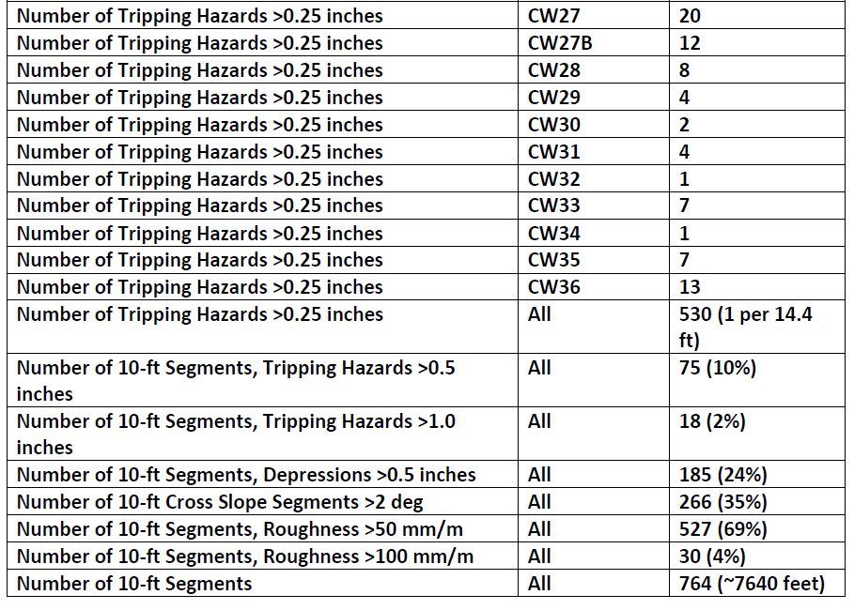
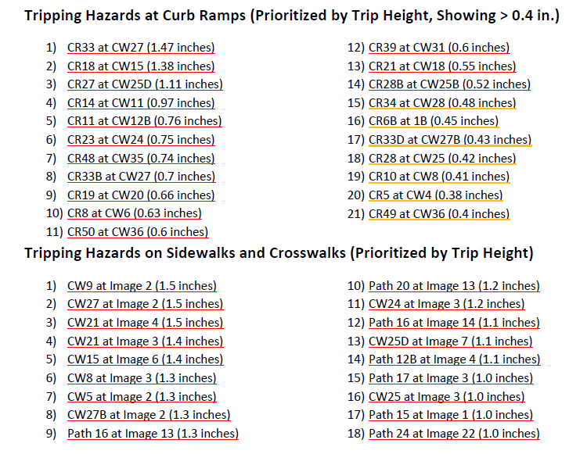
Sample Report

Slide 15
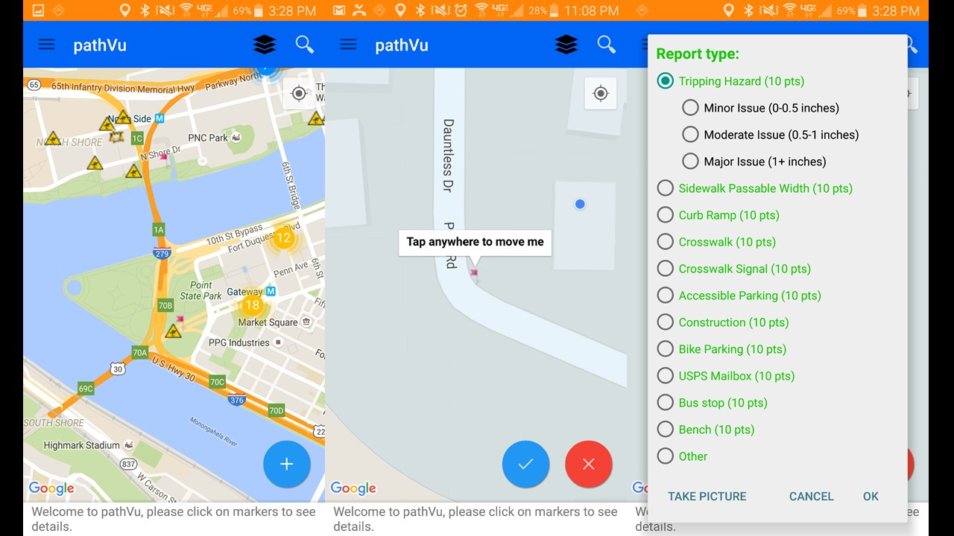
pathVu App
Crowdsource sidewalk data
Report
Type
Location
Quality
Image

Slide 16
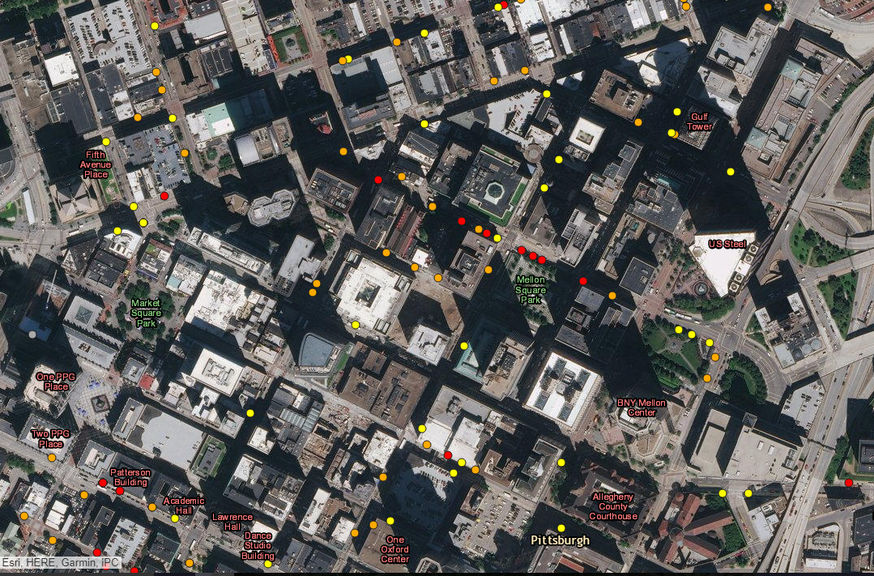

Slide 17
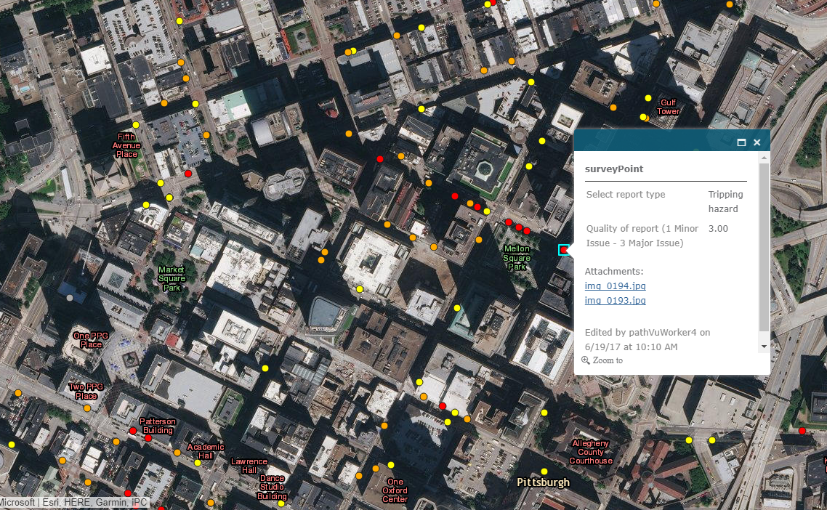

Slide 18
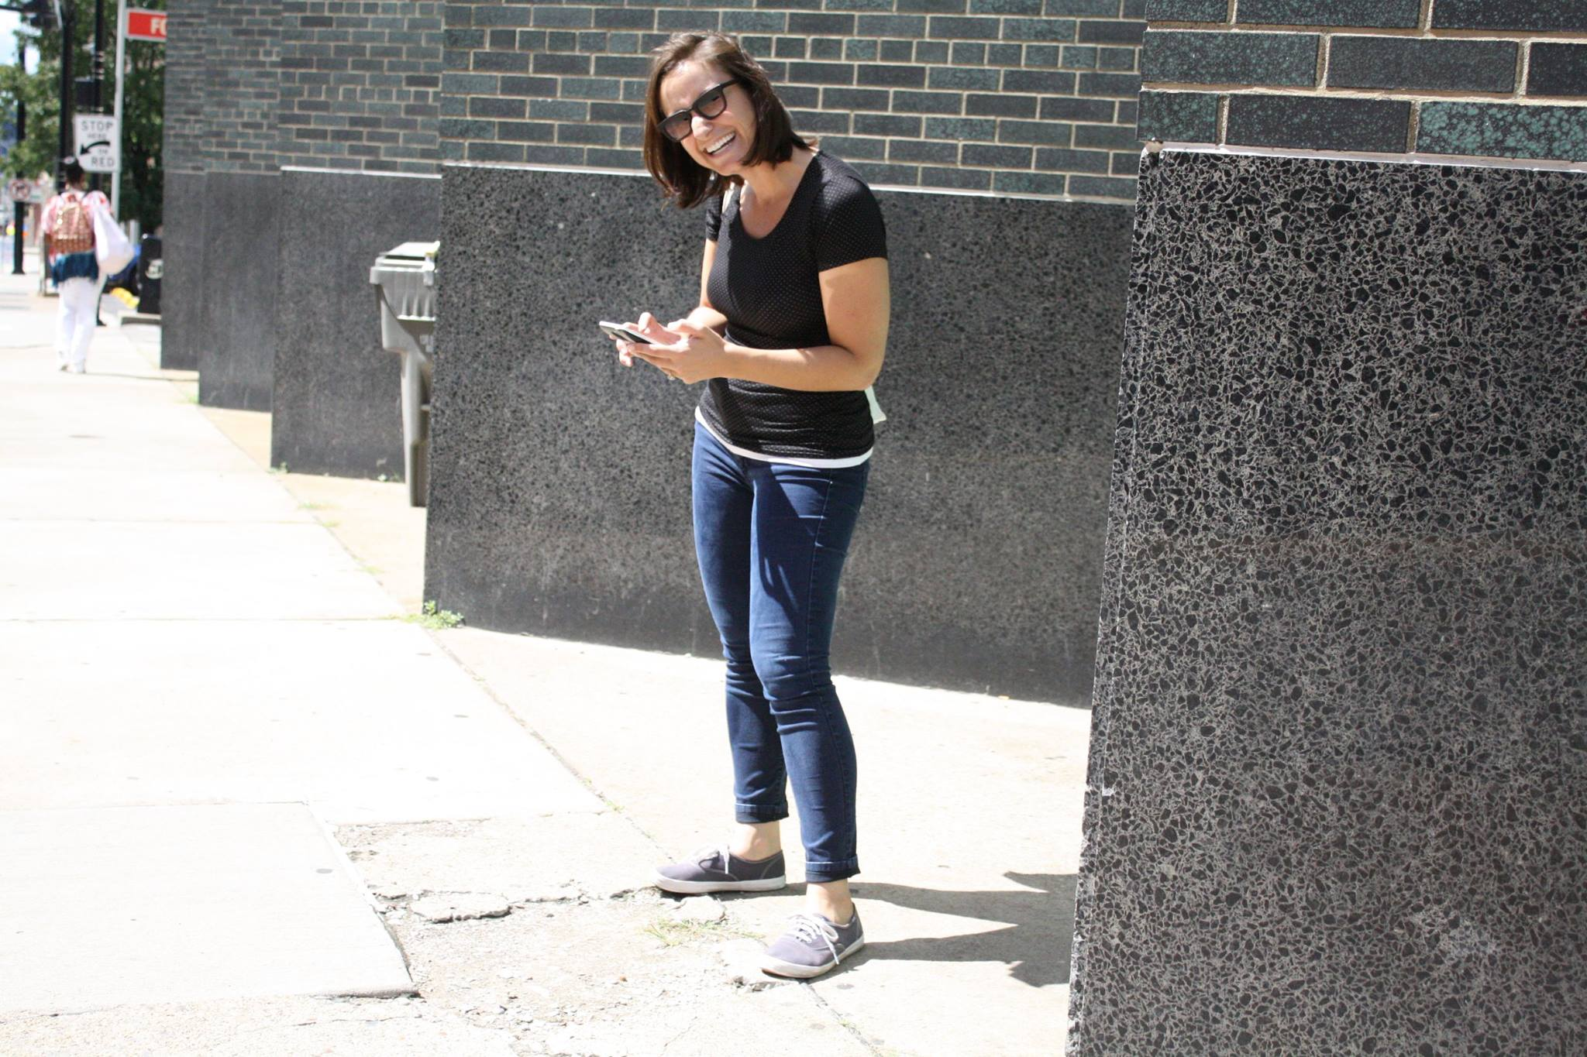
Data Collection
1 . Data Collection is organized by Lively Pittsburgh and pathVu including adaptive training of people with and without disabilities in the use of an iPhone or Android app, following the most travelled pedestrian routes in each neighborhood.

Slide 19
Feedback
2. Feedback and Analysis from local residents and stakeholders including those with disabilities prioritizes which hazards are most pressing to residents with mobility challenges as shown by the pathVu data.

Slide 20
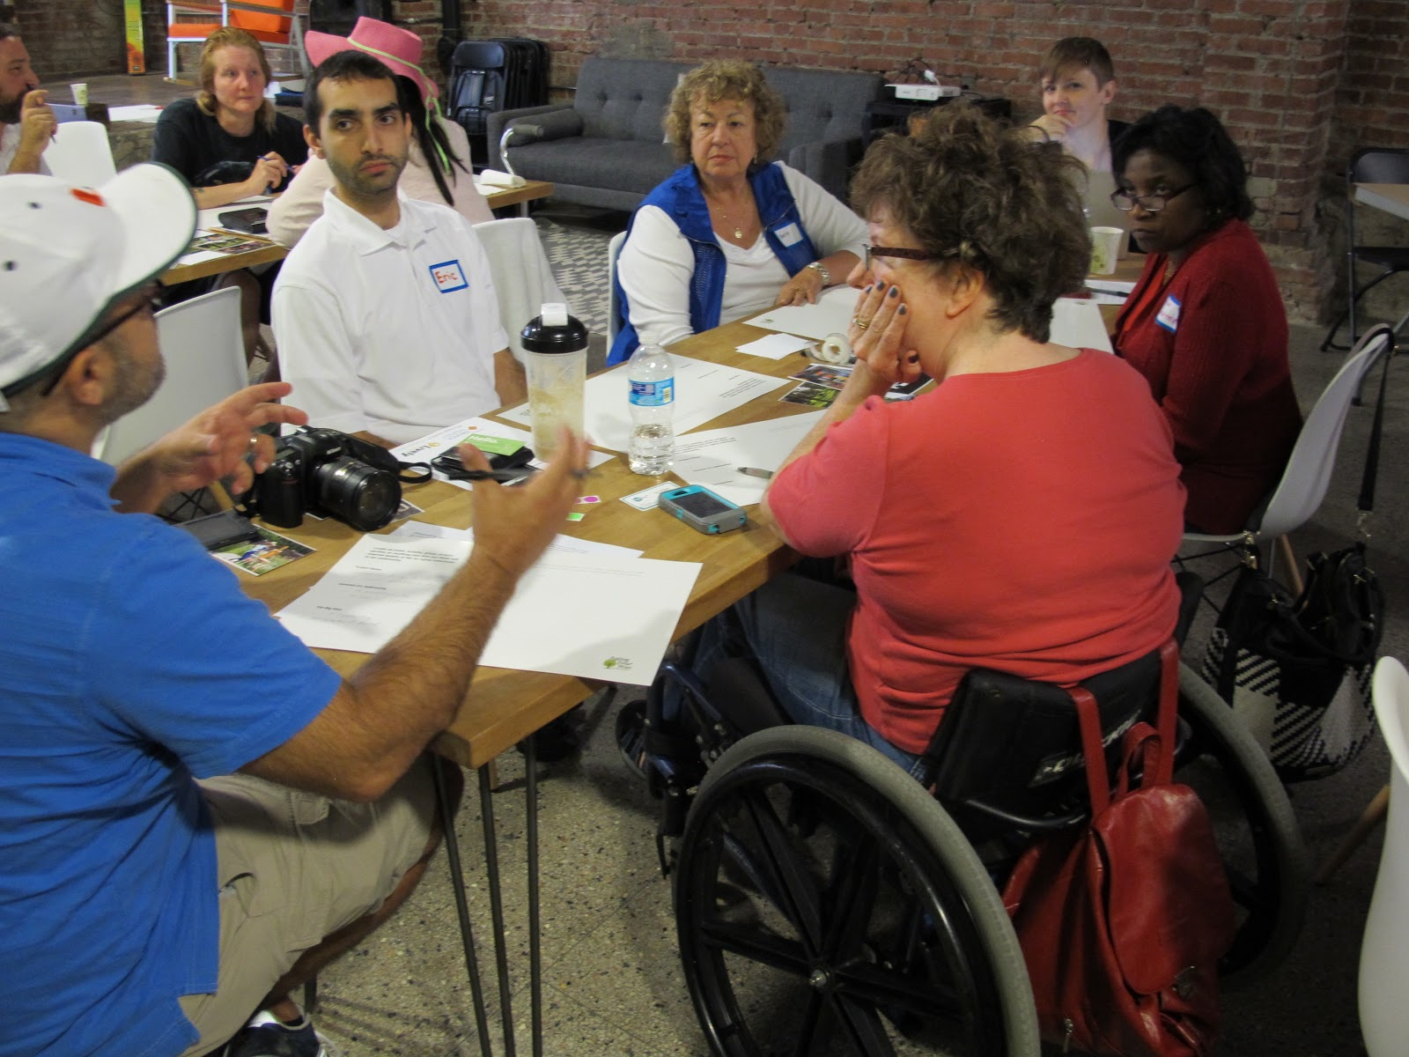
Advocacy
3. Advocacy is supported as local stakeholders including those with disabilities are invited into conversation and nurtured in their efforts to promote accessibility and walkability.

Slide 21
Pedestrian Navigation
FHWA ATTRI Contract
“Development of AccessPath: A pedestrian wayfinding tool tailored towards wheelchair users and individuals with visual impairments”
Product Launch Spring 2018
Initial Pilot in Pittsburgh
Following year: 8 additional cities

Slide 22
Pedestrian Navigation

Slide 23
Things You Can Do
Map your sidewalks/pathways using GIS software
Use crowdsourcing tools to collect pathway data in your community
Conduct a Walkability Study
Detailed full community assessment
Build partnerships

Slide 24
Partners, Customers, and Supporters

Slide 25
Case Study

Slide 26
Thank You!
Eric Sinagra, CEO eric.sinagra@pathvu.com
Nick Sinagra, Software Developer nick.sinagra@pathvu.com
www.pathvu.com

